Slide 1
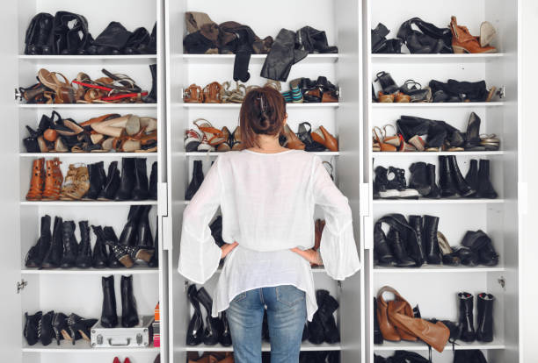
Shoes Galore
Group Project 1
Georgia Tech Data Analytics and Visualization
Avondre Henderson
Danelle Cook
Jason Degrace
Jennifer Long
Mark Alford
Rashaye Harris
Thea James

Slide 2
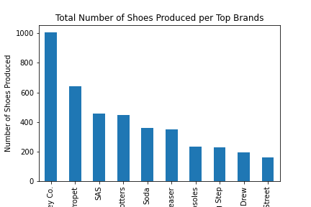
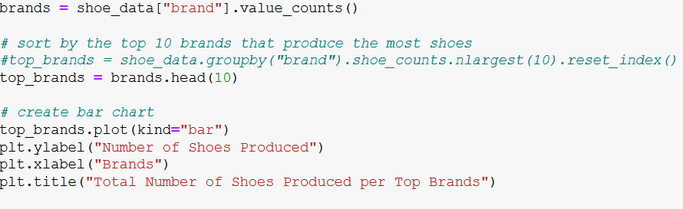
Top Brands
Bar chart of top brands
Data retrieval

Slide 3
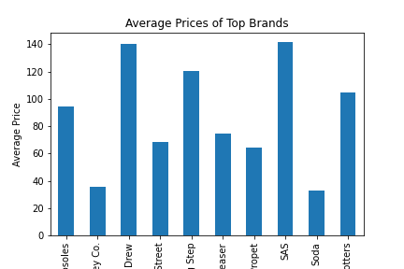
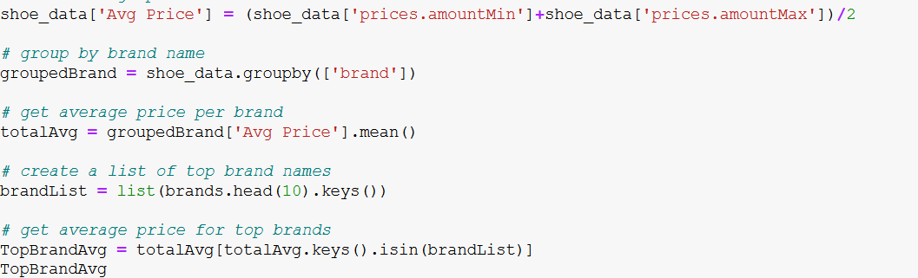
Average Price of Top Brands
Bar chart of average price
Data retrieval

Slide 4
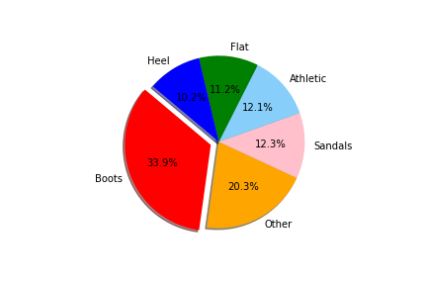
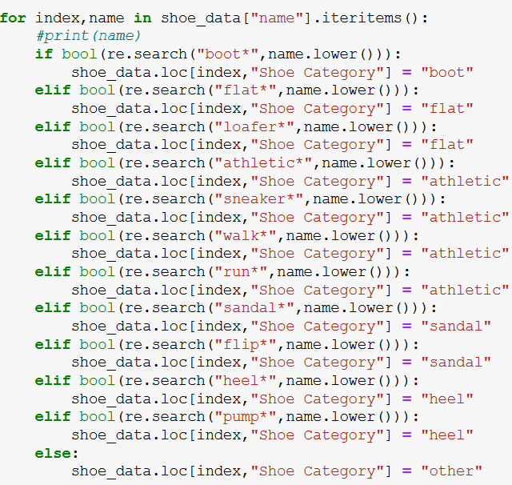
Shoe Types
Pie chart of shoe types
Data retrieval

Slide 5
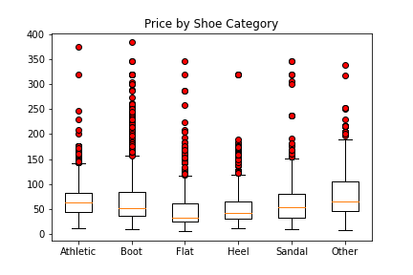
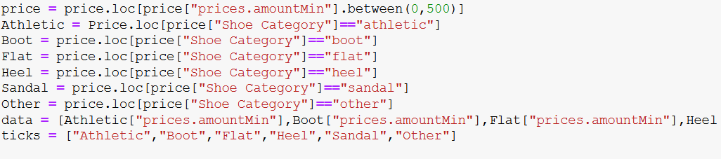
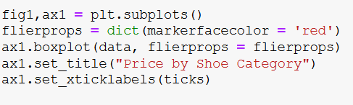
Shoe Price by Type
Box plot of shoe prices
Data retrieval

Slide 6
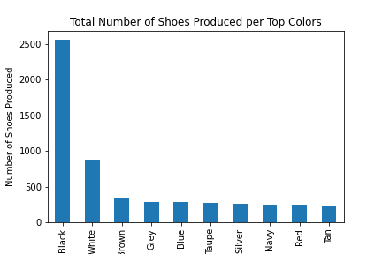
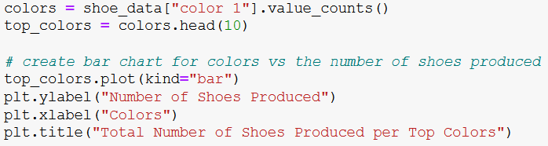
Shoe Color Totals
Bar chart for shoe colors
Data retrieval

Slide 7
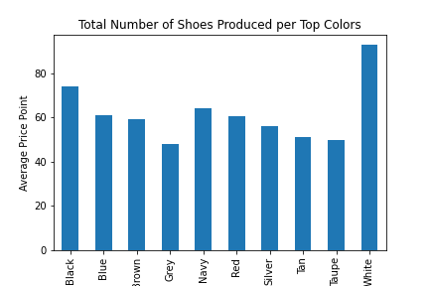
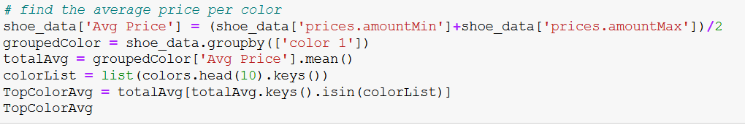
Price by Color
Average price by color
Data retrieval

Slide 8
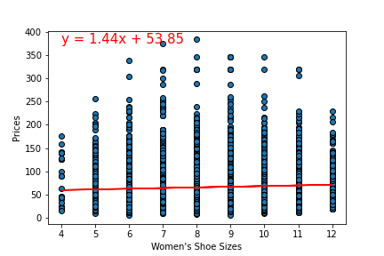
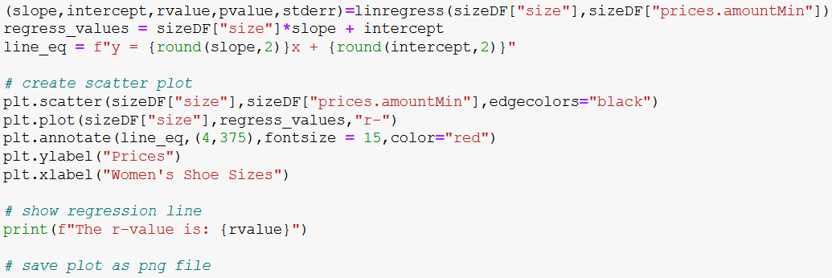
Does size effect price?
Price by shoe size
Data retrieval

